Slide 1
Clustering neighborhoods of New York and Toronto
Recommendations for people moving between two cities

Slide 2
Having handy list with similar neighborhoods may assist those moving between two cities
People invest a lot of time and effort to decide which neighborhood to chose when moving from city to city
Generally people would differentiate neighborhoods by housing prices, rent rates, crime rate, public schools availability and their rate, etc.
Generating such a list will reduce the hassle around the process of researching neighborhoods and deciding where to move.

Slide 3
Data acquisition and cleaning
New York census data is obtained from http://www.city-data.com/nbmaps/neigh-New-York-New-York.html%23N16
Toronto census data obtained from https://www.toronto.ca/city-government/data-research-maps/open-data/open-data-catalogue/
Venues data is obtained from Foursquare.com
Data cleaning involved formatting obtained data, removing unnecessary rows and normalizing it to reduce noise from absolute values.

Slide 4
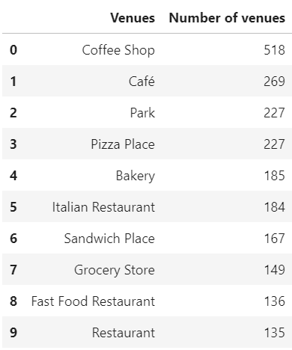
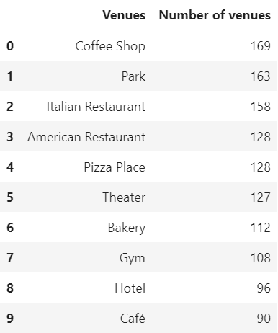
Similarity of other parameters
Toronto | New York

Slide 5
Similarity of other parameters
Toronto | New York
Median normalized population
0.6% of the total population per neighborhood | 0.7% of the total population per neighborhood
Median normalized household income in a neighborhood
18.7% of the most wealthy neighborhood | 52.5% of the most wealthy neighborhood
Median normalized area of a neighborhood
8% of the largest neighborhood | 3.2% of the largest neighborhood

Slide 6
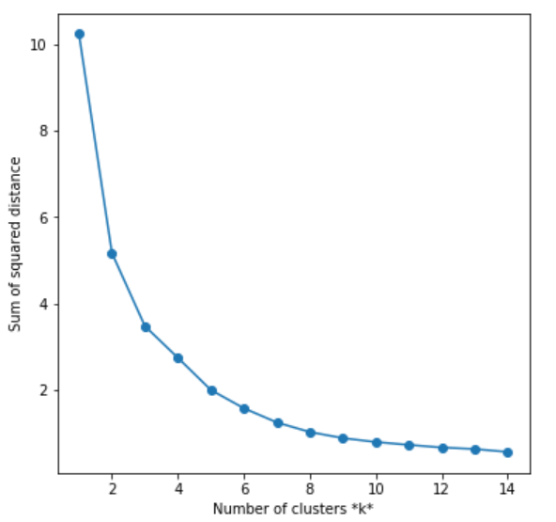
K-means clustering
After k = 5 the slope of the graph notably changes, thus, for the purpose of clustering the neighborhoods of New York and Toronto I picked k = 5.

Slide 7
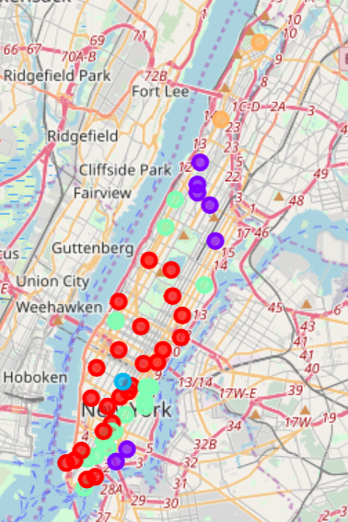
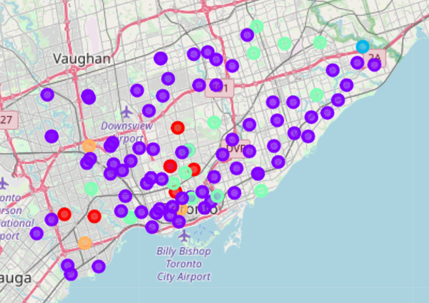
Mapped clustered neighborhoods
Toronto | New York

Slide 8
Conclusion and future direction
Built a model to cluster neighborhoods in different cities
Model is highly sensitive to the parameters picked for clustering
Capture more information which is crucial for any person in deciding which neighborhood to move in
Parameters that might be useful:
Housing prices;
Rent rates;
Crime rates;
Public school info.

